Slide 1

Library Management System
Submitted by: Abdulrahman Hussein Ali -> Reg-No. 18101548 Fady Samy Goda -> Reg-No. 18102062 Shehab Badawy Mohamed -> Reg-No. 18103259

Slide 2

Objectives
The program runs several complex library operations and maintains them such as new purchases to the inventory, selling books, borrowing books, adding new students and teachers, handling the finance of the library and many other operations.
The data entered by the librarian is saved in a data base and recalled upon further runs of the program.

Slide 3
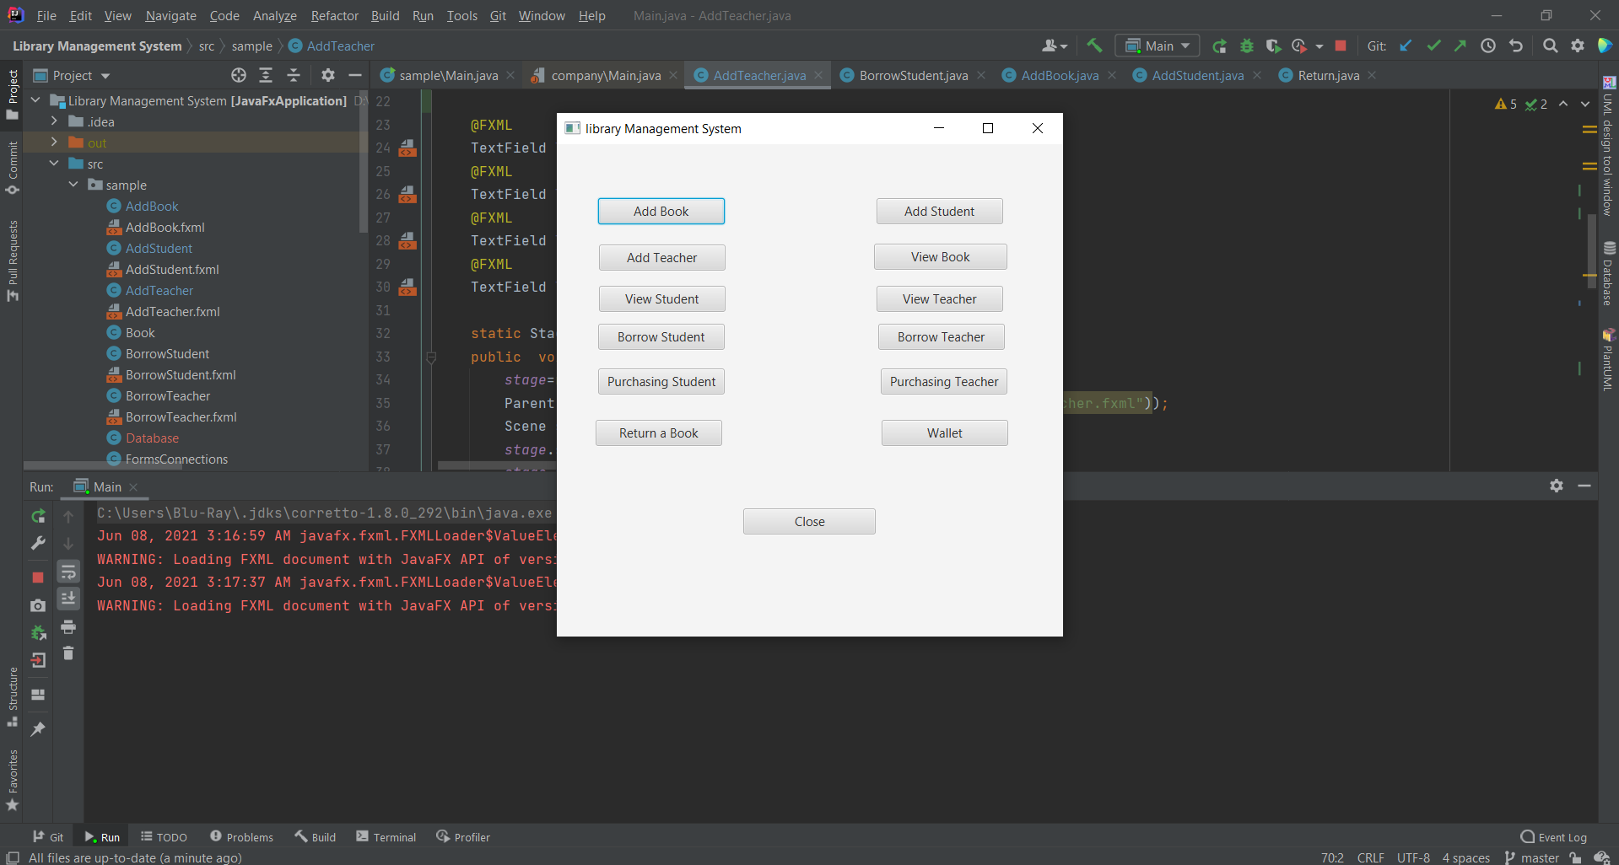

Slide 4
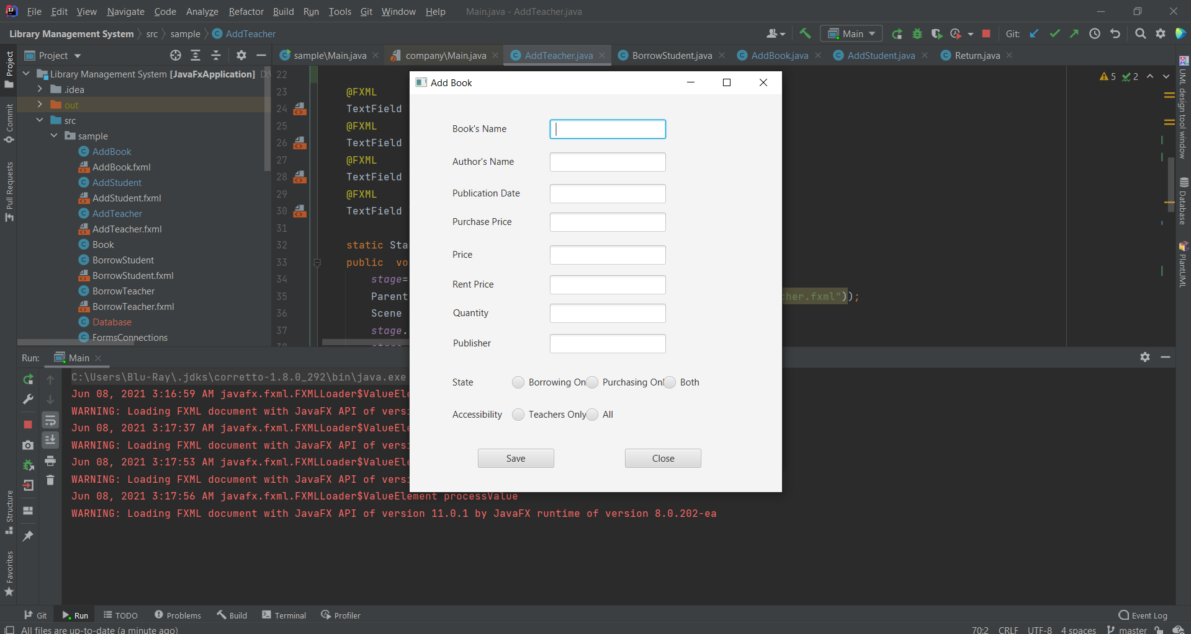

Slide 5
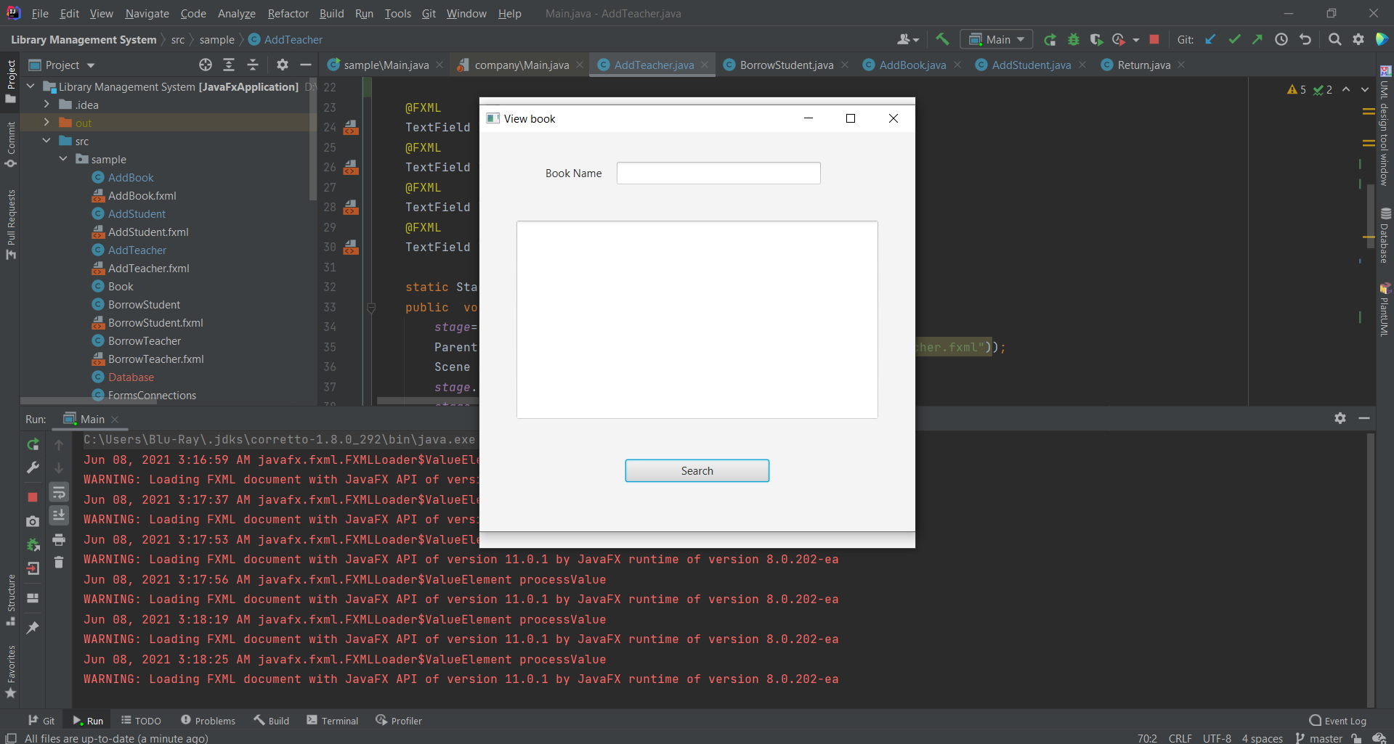

Slide 6
